Slide 1
DS 5110: Mini-Project Data Report 6/27/2024

Slide 2
AGENDA
Database Model
Single-Field Overview
Multi-Field Relationships

Slide 3
Database Model
total_output.db [all_noisy_table]
INDIVIDUAL
ID
Name
Age
City
Salary
JoinDate

Slide 4
AGENDA
Database Model
Single-Field Overview
Multi-Field Relationships

Slide 5
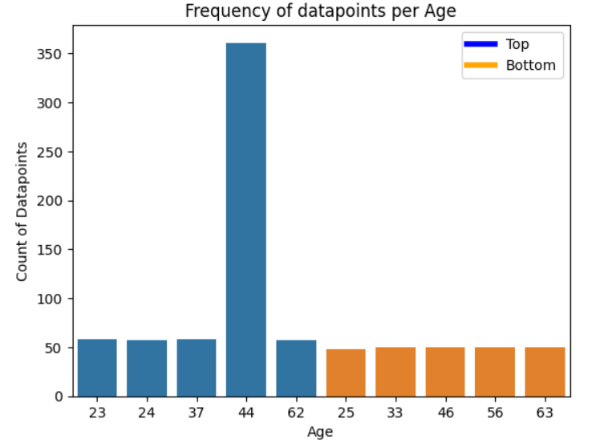
Age Summary

Slide 6
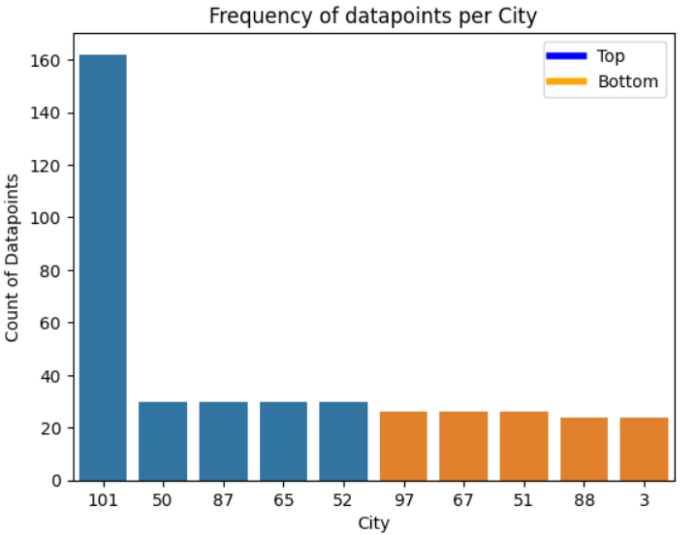
City Summary
N Individuals per City
Mean – 29.70
N Individuals per City Excluding City_101
Mean – 28.38

Slide 7
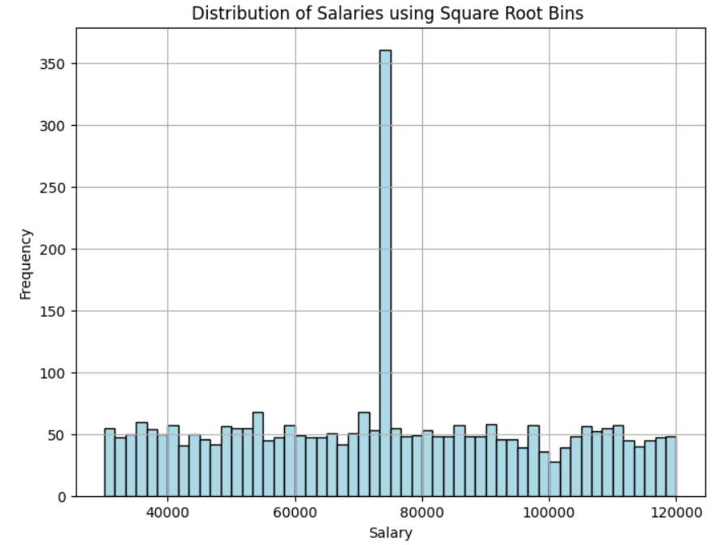
Salary Summary

Slide 8
AGENDA
Database Model
Single-Field Overview
Multi-Field Relationships

Slide 9
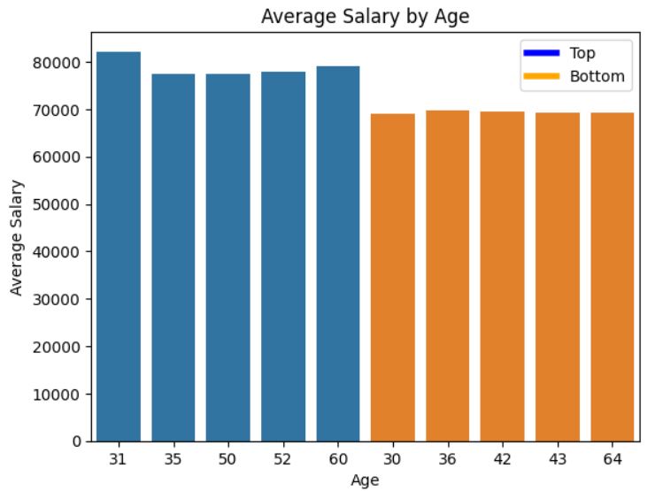
Salary by Age

Slide 10
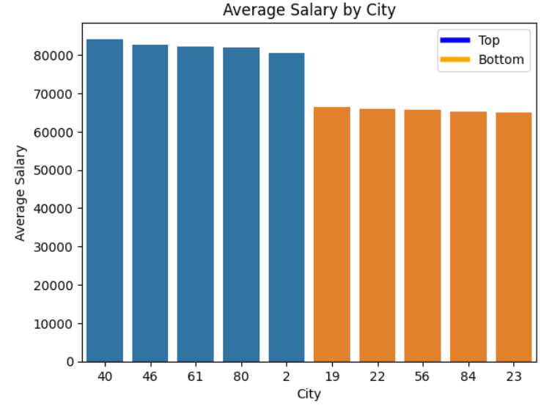
Salary by City

Slide 11
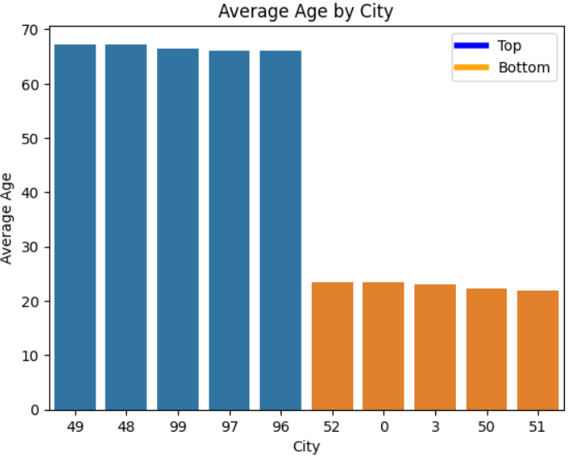
Age by City

